Slide 1
Cybersecurity CSCI 2413 Final Review

Slide 2
Protocols/Ports
Protocol | Port
FTP | 20, 21
SSH | 22
Telnet | 23
SMTP | 25
DNS | 53
HTTP | 80
POP3 | 110
LDAP | 389
HTTPS | 443
RDP | 3389

Slide 3
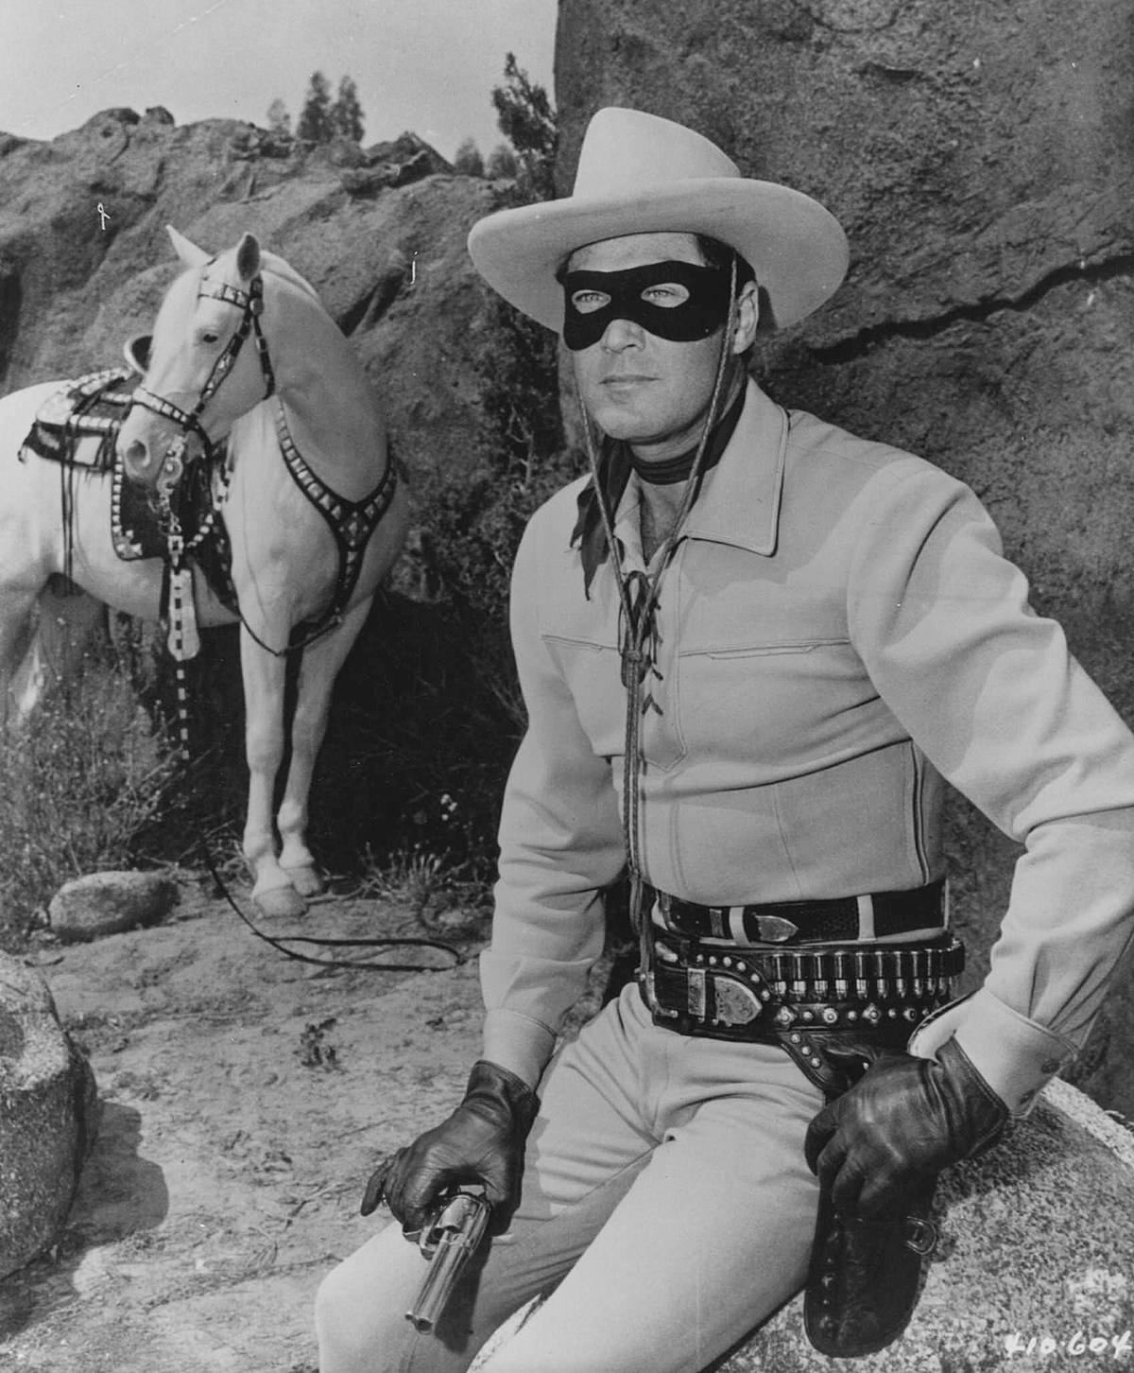
Types of Hackers
A white hat hacker is usually called a penetration tester today; It is someone who is hacking with permission of the owners of the target system
A black hat hacker is the person who gains access to a system in order to cause some type of harm; Black hat hackers are sometimes referred to as crackers
A gray hat hacker is normally a law-abiding citizen, but in some cases will venture into illegal activities

Slide 4
Penetration Testing (PenTester)
Also know as Ethical Hacker is some one that is AUTHORIZED to simulate a cyber attack against a computer or server.
Pen Testers are usually a company or security firm that performs several attacks on a company and provides a report to the company of any vulnerabilities found and how to fix any issues found.

Slide 5
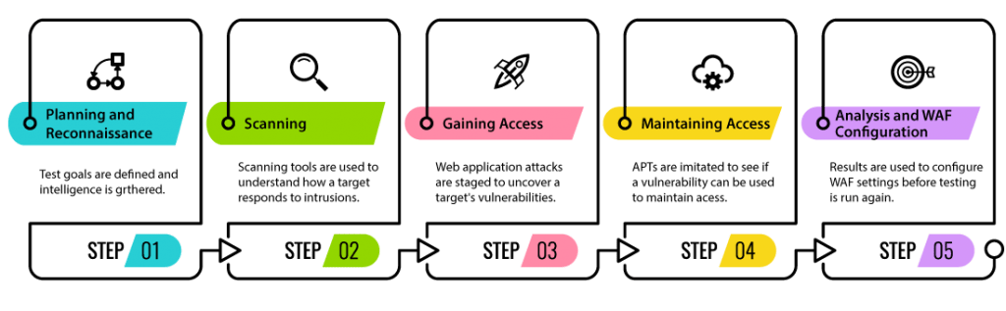
Penetration Testing Stages

Slide 6
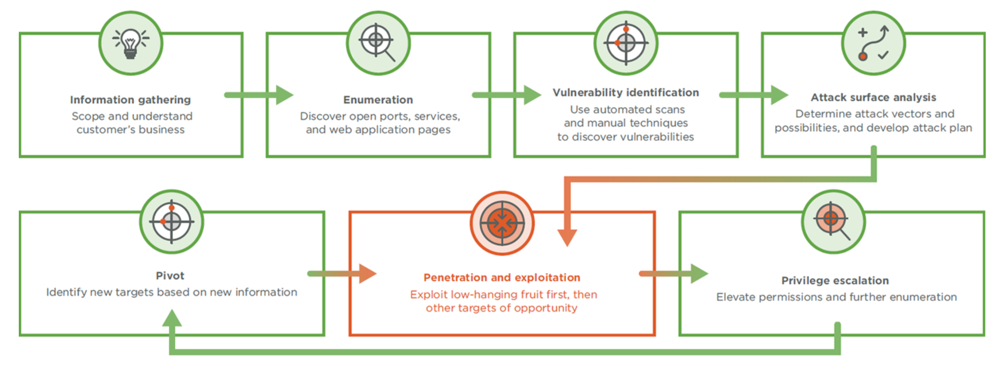
Penetration Testing Stages

Slide 7
OWASP
The Open Web Application Security Project (OWASP)
Non-profit foundation working to improve security of software
They Provide
Tools
Community and Networking
Education and Training
https://owasp.org

Slide 8
OWASP Top Ten
OWASP releases a Top 10 most common flaws in software every 3-4 years
Current Top 10 is from 2021
Categories
Exploitability
Prevalence
Detectability
Technical
https://owasp.org/www-project-top-ten/

Slide 9
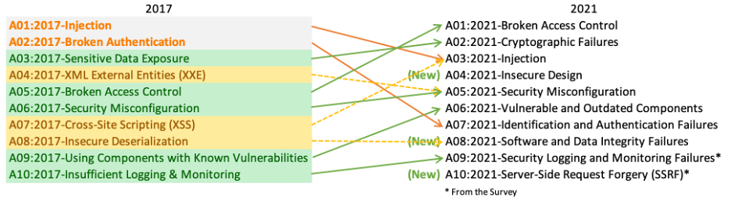
OWASP Top Ten (new in 2021)
https://owasp.org/www-project-top-ten/

Slide 10
A1: Broken Access Control
Access control enforces policy such that users cannot act outside of their intended permissions.
Failures typically lead to unauthorized information disclosure, modification, or destruction of all data or performing a business function outside the user’s limits.
https://owasp.org/Top10/A01_2021-Broken_Access_Control/

Slide 11
Vulnerabilities
Violation of the principle of least privilege or deny by default.
Bypassing access control checks by modifying the URL (parameter tampering)
Permitting viewing or editing someone else’s account
Accessing API with missing access controls for POST, PUT, DELETE
Elevation of privilege acting as a user without being logged in
Metadata manipulation, such as replaying or tampering with a JSON Web Token (JWT)
Force browsing to authenticated pages as an unauthenticated user to privileged pages as a standard user.

Slide 12
Web HTTP Methods
The web sends data back and forth from server to the client using HTTP Methods
GET – retrieves data from the server
PUT – sends updated data to the server
POST – sends new/created data to the server
DELETE – removes data from the server

Slide 13
HTTP Status Codes
There are several status codes that are returned from the server
40X
400 – Bad Request
401 – Unauthorized
403 – Forbidden
404 – Not Found
50X
500 – Internal Server Error
503 – Service Unavailable
20X
200 – OK
201 – Created
204 – No Content
30X
301 - Moved Permanently
304 – Not Modified

Slide 14
How to Prevent
Deny by default
Use of Cross-Origin Resource Sharing (CORS)
Disable web server directory listing
Log access control failures and review periodically
Make sure that the correct user is making the change Use tokens for authentication https://jwt.io
Make Ids harder to guess (non-numeric) https://guidgenerator.com/

Slide 15
A2: Cryptographic Failures
Previously referred to as Sensitive Data Exposure
Protection of the data in transit and at rest.
- Passwords
- Credit Cards
- Health Records
- Personal Information (PII)
https://owasp.org/www-project-top-ten/OWASP_Top_Ten_2017/Top_10-2017_A3-Sensitive_Data_Exposure

Slide 16
Is the Application Vulnerable?
Is any data transmitted in clear text?
What version of cryptography is being used? SHA1, MD5….
Are the default crypto keys in use weak? How were they generated?
Is the certificate chain from the CA validated? Has it expired?
Are the same keys being used on multiple servers?

Slide 17
Classify Data
Need to determine the sensitivity of all data elements being transmitted and stored
Is it a company secret?
Is there legal requirements for the data?
Is it someone's Personally Identifiable Information (PII)?
Is it someone’s Health Data (HIPPA)
Is it a Password, PIN code, Security Question Answer?

Slide 18
Classify Data
Once the data has been classified determine the best way to store/transmit it.
Passwords, PIN codes… - Hashed
User personal information – Encrypted
User health information - Encrypted
Company Private Info - Encrypted
Company Public info – Plain Text
User Public info – Plain Text

Slide 19
Transmit Data
HTTP (Web) is not secure all web sites should use HTTPS (Secure Web)
FTP (File Transfer) is not secure all servers should use FTPS (Secure File Transfer)
SMTP (Mail) is not secure…. There is not a Secure Mail protocol but several mail programs/online solutions allow encrypting and decrypting of mail (Gmail)

Slide 20
Secure Email
There are add-ons for some email clients that allow you to encrypt and decrypt email messages it work on the Public Key encryption where both the sender and receiver have a public key they can use to encrypt messages and use their private key to decrypt.
Does take some coordination between both parties

Slide 21
Credit Cards
Payment Card Industry (PCI) have a set of standards to follow when storing or handling credit cards.
They don’t encourage companies to store credit cards
If you web site has reoccurring payments the recommendation is to use a token (encrypted value) from a credit card clearing company (First Data)
https://www.pcisecuritystandards.org/index.php

Slide 22
Data Storage
Don’t store sensitive data if you don’t have to.
Truncate the data (Last 4 of SSN)
At least encrypt it if you must store it
Move the data to an internal system if your site doesn’t need the data
Hash data that just needs to be compared/matched and not displayed.

Slide 23
How to Prevent?
Classify data processed, stored, or transmitted into sensitivity levels
Classification my have to take in consideration laws and reguations
Don’t store sensitive data if you don’t have to
Encrypt all sensitive data at rest
Use up to date and standard cryptography
Use TLS 1.2 or above
Disable caching sensitive data

Slide 24
A03: Injection Attacks
Injection is most commonly exploited through a SQL Injection attack but there are many injection attacks including:
SQL, NoSQL, Command, OS and LDAP
Injection attacks result from untrusted data being sent or processed without validation

Slide 25
Is the Application Vulnerable?
User-supplied data that is NOT validated
Dynamic queries are not parameterized
Hostile data is directly used or concatenated in the input

Slide 26
Relational Databases
One of the most efficient ways to store data is in a relational database
Relational databases have Tables and those tables have columns and rows similar to an Excel spreadsheet
These tables can be queried using a language called Structured Query Language (SQL)

Slide 27
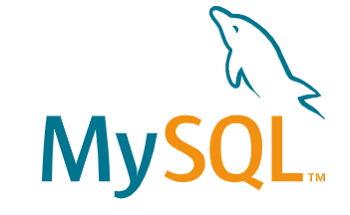


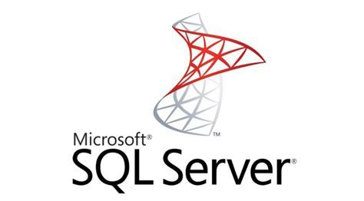

Relational Database Options
FREE
MySQL
POSTGRES
Enterprise
Microsoft SQL Server
Oracle
IBM DB2

Slide 28
MySQL
https://www.mysql.com/
Owned by Oracle
One of the most popular FREE Relational Databases
Provides Server and management consoles for multiple operating systems (Windows, MacOS, Unix)

Slide 29
Tables, Rows, Columns
Every table is given a name like “Users”, “Products”…
Tables have columns of like “Name”, “Username”, “Email”…
Tables can have multiple rows of data
Id | Name | Username | Email | Password
1 | Jeff | Jmaxwell | jmaxwell@okcu.edu | Password#123
2 | John | Jsmith | jsmith@okcu.edu | Password#123
3 | Tom | Hanks | thanks@okcu.edu | Password#123

Slide 30
Create, Read, Update, Delete (CRUD)
Relational database provide a way to Create data, Read data, Update data, and Delete data (CRUD)
In SQL we use the following keywords:
CREATE = INSERT INTO
READ = SELECT
UPDATE = UPDATE
DELETE = DELETE

Slide 31
READ - SELECT
SELECT [columns] FROM [table]
[columns] can be one or multiple columns in a comma delimited list or “*” which means all columns.
Examples:
SELECT * FROM Users
SELECT Name, Email FROM Users

Slide 32
WHERE Clause
WHERE Clause allows filtering rows in the table by specific columns
SELECT [columns] FROM [table] WHERE [column] = [value]
Examples:
SELECT * FROM Users WHERE Name=‘Jeff’
Id | Name | Username | Email | Password
1 | Jeff | Jmaxwell | jmaxwell@okcu.edu | Password#123

Slide 33
WHERE Examples
SELECT * FROM Users WHERE Id=2
SELECT * FROM Users WHERE Name LIKE ‘J%’
Id | Name | Username | Email | Password
2 | John | Jsmith | jsmith@okcu.edu | Password#123
Id | Name | Username | Email | Password
1 | Jeff | Jmaxwell | jmaxwell@okcu.edu | Password#123
2 | John | Jsmith | jsmith@okcu.edu | Password#123

Slide 34
CREATE – INSERT INTO
INSERT INTO [table] ([columns]) VALUES ([values])
When inserting (creating) data in a table a comma delimited list of columns and values are passed.
Examples:
INSERT INTO Users (Id, Name, Email,….) VALUES (4, ‘Hank’, ‘hank@okcu.edu’,….)

Slide 35
UPDATE – UPDATE
UPDATE [table] SET [column]=[value]
WHERE [column]=[value]
Need to be careful when updating data and include a WHERE clause otherwise all records in table will be changed.
Examples:
UPDATE Users SET Name=‘Jeff Maxwell’
WHERE Id=1

Slide 36
DELETE – DELETE
DELETE FROM [table]
WHERE [column]=[value]
Need to be EXTRA careful when deleting data and include a WHERE clause otherwise all records in table will be DELETED.
Examples:
DELETE FROM Users WHERE Id=1

Slide 37
SQL Query
SELECT * FROM Users Users;
Id | Name | Username | Email | Password
1 | Jeff | Jmaxwell | jmaxwell@okcu.edu | Password#123
2 | John | Jsmith | jsmith@okcu.edu | Password#123
3 | Jane | jsmith2 | jsmith2@okcu.edu | Password#123

Slide 38
How SQL Injection Works
A login screen requires a username and password, which is checked against a database
SQL injection adds OR X=X to the end of the password
The result of X=X is always true, so that string will return a value of True to the website
If the code is not well written, this can trick the website into believing the correct password has been entered

Slide 39
SQL Injection
SELECT * FROM Users
WHERE username=‘jmaxwell’ AND password=‘Password#123’;
String sql = “SELECT * FROM Users WHERE username=‘“ + username + “’ AND password=‘” + password + “’”;

Slide 40
SQL Injection
What if pass is jmaxwell' or '1'='1' --
String sql = “SELECT * FROM Users WHERE username=‘“ + username + “’ AND password=‘” + password + “’”;
SELECT * FROM Users WHERE username=? AND password=?
SELECT * FROM Users
WHERE username=‘jmaxwell’ or ‘1’=‘1’ -- AND password=‘xxx’

Slide 41
A04: Insecure Design (New in 2021)
Insecure Design is a very broad category including a lot of potential issues:
“Missing or Ineffective Control Design”
What are the Risks?
How are the Risks being managed?

Slide 42
What is Secure Design
Secure Design is not just a diagram it is more of a change in thinking, culture and approach to building software and hardware systems.
You need methodologies and a constant drive as a corporation to make things more secure starting with the Design.

Slide 43
What is Secure Design
Secure Design is not just a diagram it is more of a change in thinking, culture and approach to building software and hardware systems.
You need methodologies and a constant drive as a corporation to make things more secure starting with the Design.

Slide 44
Threat Modeling
Threat Modeling is the practice of reviewing current Application diagrams and look for potential secure issues.
How does the data flow?
Is Encryption being used?
Who has access to WHAT?

Slide 45
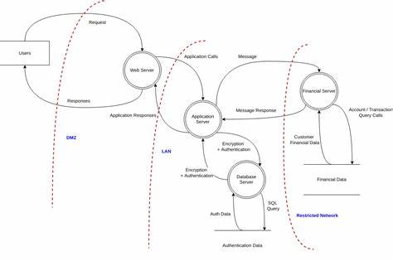
Threat Modeling

Slide 46
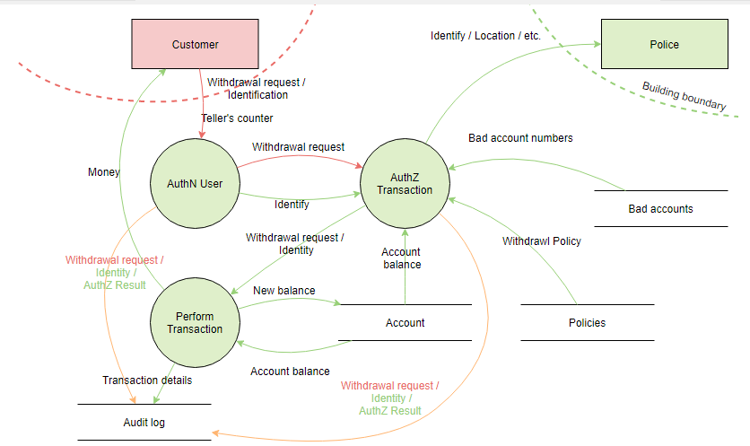
Threat Modeling

Slide 47
Data
What data is being stored?
How is the data classified?
What data is being Hashed/Encrypted? Why or Why Not?
Who has access to the data?
What data is being sent to other sources (outside companies)?

Slide 48
Data Flow
How does the data flow between systems?
What are the inputs/outputs?
Is the data transferred in plain text or cipher text?
What encryption methods are being used for cipher text?

Slide 49
Security Assessment
Has a security Assessment been performed?
When was the last one?
What were the findings?
How was it performed?
OWASP Software Assurance Maturity Model (SAMM) https://owaspsamm.org

Slide 50
How to Prevent
AppSec (Application Security) professionals need to be a part of the design and discuss security early in the design progress
Build a library of Secure Design patterns or reference example code that is secure for the teams to use.
Use Threat Modeling for critical systems and diagram the authentication, access control and authorization patterns
Diagram/Document the Data flows between systems

Slide 51
How to Prevent
Create User Stories/Requirements to test and validate that your system is not vulnerable to known attacks (SQL Injection, XSS, CSRF…)
Test and validate your design
Have a PenTester try to hack the application/servers in the system

Slide 52
A05: Security Misconfiguration
Security Misconfiguration deals with systems and software not being setup properly.
Attackers like to target unpatched flaws that other attackers have already found.
Attackers look for unprotected files and folders
A lot of default configurations leave servers vulnerable

Slide 53
A05: Security Misconfiguration
Lack of OS/System Hardening
Missing latest patches or security patches
Services running that shouldn’t be
Features installed that need to be removed
Open Ports or Protocols
Error handling that shows stack trace with security information
Default settings sometimes allow too much access

Slide 54
Why does this happen?
A lot of administrators setup systems and don’t know what default values are configured
Companies do not use automated tools to patch their systems and sometimes systems are missed
Default configurations are used

Slide 55
How to Prevent
Work with administrators and network admins to “Harden” the server “Lock it down”
Remove any default accounts
Remove any unused Services
Turn off any unused Ports
Add default error handling
Take a least privilege approach to everything

Slide 56
How to Prevent
Create a secure version of each OS that can be used when building new systems
Security Testing and automated tools
Log Server Errors and Applications errors (AND LOOK AT THEM)

Slide 57
A06: Vulnerable and Outdated Components
In modern development we use a combination of 3rd party components to provide us with features/functionality.
A lot of these components could have a vulnerablity

Slide 58
Is my application vulnerable?
Probably
If you use any 3rd party components
If you are not regularly scanning for vulnerabilities
If you are several versions behind on the framework or tools you use

Slide 59
Why does this happen?
A lot of 3rd party software is Open Source (hosted on GitHub or GitLab) and it is up to the author to update their software, scan for vulnerabilities, fix and deploy new versions.
If my Open Source Project doesn’t make any money it might not be a high priority for me.
All commercial (paid for) software should patch their software regularly (if not look for new software)

Slide 60
Tools
National Vulnerability Database (NVD) https://nvd.nist.gov
GitHub/GitLab have built-in scanners
OWASP Dependency Checker
https://owasp.org/www-project-dependency-check/
Snyk.io https://snyk.io

Slide 61
NPM
Node Package Manager (NPM)
npm ls [package name]
npm audit [fix]
npm update

Slide 62
How to Prevent
Patch, Patch, Patch as a normal process in the development cycle
Remove Unused Dependencies (This can be challenging)
Use a scanner or add a scanner into your build/deployment pipelines (CI/CD)
Only use components from an official site/source

Slide 63
How to Prevent
Create a local repository that the development team uses to pull updates and update the repository regularly
Have scheduled releases updates (once a quarter, month, or week)
Don’t let the frameworks (in your application) get behind more than one or two versions.

Slide 64
A07: Identification and Authentication Failures
Formally #2 (in 2017) and named “Broken Authentication” moves to #7 due to increased secure and better management of Authenticated users.
Authentication relates to session management or logins that are implemented incorrectly.
Hackers can exploit the and login as other users or gain access to pages or systems they should not have access to.

Slide 65
Does your Application?
Permit automated attacks such as credential stuffing, where the attacker has a list of valid usernames and passwords?
Permits brute force or other automated attacks?
Permits default, weak or well-known passwords, such as “Password1” or “admin/admin”?
Uses weak forgot-password processes – knowledge based answers

Slide 66
How is login validated/manage?
Uses plain text, encrypted or hashed passwords without salt (A02: 2021 Cryptographic Failures)
Not using Multi-factor Authentication
Pages that don’t validate the user session or validate access to a page

Slide 67







Credential Stuffing
The hacker uses stolen account credentials form other hacks and tries them on other sites.
Have I Been Pwned? Has over 9 Billion hacked accounts from previous breaches.
https://haveibeenpwned.com/

Slide 68
Brute Force Attacks/Weak Passwords
Taking commonly used passwords and try them for each account
https://github.com/danielmiessler/SecLists/blob/master/Passwords/darkweb2017-top10000.txt
Easy to exploit if system allows simple passwords.
HASHCAT

Slide 69
Weak forgot-password process
Have you ever used a forgot password feature and it emailed you your password?
NOT HASHED
What if you enter you email for a forgot password and it says that email/username does not exist?
Why is that bad?

Slide 70
Plain text passwords or Encrypted Passwords
Plain text ARE BAD
You should hopefully KNOW this by now.
Encrypted passwords are a little better but anything encrypted can be decrypted so it is also BAD.
You should ALWAYS Hash passwords with a RANDOM Salt value for each user.

Slide 71
How to fix Broken Authentication?
Implement Complex Password Requirements
Implement Account lockout with too many failed attempts****
HASH passwords with a random SALT
Implement Multi-Factor Authentication

Slide 72
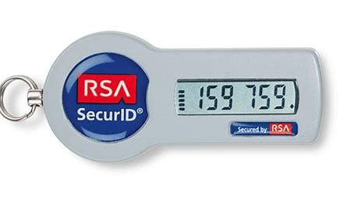
Credential Stuffing
Keep track of the number of failed login attempts and alert on a threshold to the user/admins
Implement Multi-Factor (Email, Text, QR code scan, RSA Token)
https://haveibeenpwned.com/

Slide 73
Brute Force Attacks/Weak Passwords
Keep a bad password list and when a user signs up or tries to change their password check to see if it is NOT in the bad password list.
Setup complex password rules
Passwords must be 8 or more characters (> 15 is better)
Passwords must contain both upper and lower case letters
Passwords must contain at least 1 special character (!@#$%^&*)

Slide 74
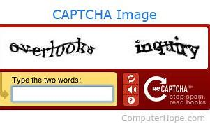
Brute Force Attacks/Weak Passwords
Don’t have a small limit of how long a password can be
“Hello my name is Jeff Maxwell and I like to Teach #1 3 5” – Is harder to hack than P@$$w0rd123

Slide 75
Weak forgot-password process
Never email the user their password (EMAIL is in clear text across the web)
Don’t tell the user (hacker) their email/username doesn’t exist. If you do then can use the forgot password to narrow down the list of users who have accounts before they attack
Instead always say something like “If an email/username exists password reset instructions will be emailed” (continue)

Slide 76
Weak forgot-password process
Instead always say something like “If an email/username exists password reset instructions will be emailed” (continue)
If someone requests to reset their password send them a link (URL) with a random code that is associated with the user account if they go to the link let them reset their password
Ask them to type in a code from a text.

Slide 77
Plain text passwords or Encrypted Passwords
You should ALWAYS Hash passwords with a RANDOM Salt value for each user.

Slide 78
Session Management
Once a user has logged in you need to make sure that each page they access they should have access to that page.

Slide 79
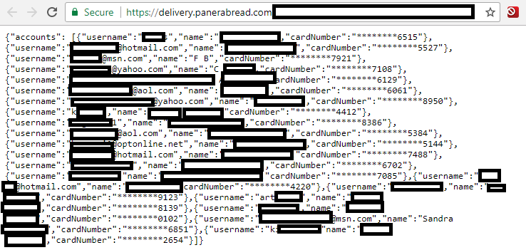
Session Management
Panera Bread was notified that they were not validating users when they navigated between pages and wasn’t using the correct Session Management restricting access.
https://panerabread.com/users/1234 could be changed to access other user accounts

Slide 80
Panera Bread – KrebsOnSecurity
Dylan Houlihan reached out to Panera Bread and they said they were aware and were working on it.
8 months later Dylan had not heard anything and the problem still existed so he reached out to Brian Krebs at https://krebsonsecurity.com
Krebs reached out to them with no response published a blog post about it https://krebsonsecurity.com/2018/04/panerabread-com-leaks-millions-of-customer-records/ and several newspapers/news channels picked up the story.

Slide 81
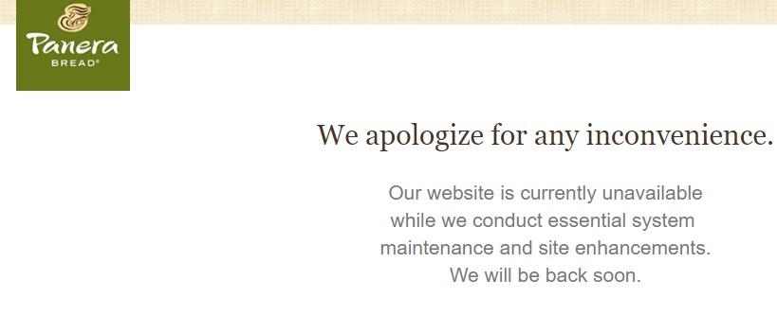
Panera Bread – KrebsOnSecurity

Slide 82
A08: Software and Data Integrity Failures
This is a new category added for 2021 and deals with making the assumptions that things are working without verification

Slide 83
Software and Data Integrity
Relates to code and infrastructure that does not protect against integrity violations
Cloud Servers, Content Delivery Networks (CDNs) and insecure CI/CD pipelines for deployment
Many applications now include auto-update functionality where updates are downloaded without sufficient integrity verification

Slide 84
How to Prevent
Digital Signatures to validate who created the update
Manage your own internal NPM or NuGet libraries for 3rd party controls
After each deployment calculate a HASH on the files/folders and compare the the HASH that is expected (run this at least once a day)

Slide 85
How to Prevent
Security and Code Scans
Manual Code Reviews of changes
CI/CD don’t store passwords and limit access

Slide 86
A09: Security Monitoring and Logging Failures
Previously known as “Insufficient Logging and Monitoring” this item moves up from #10 to #9
This mainly deals with traffic and the health of an application

Slide 87
Logging
Capture all traffic and activity to a site
Disk Space is cheap log as much as you can offload to another server
Never leave the logs on the server in case the server is compromised and altered by the hacker

Slide 88
Logging
What is the application logging by default?
What should you be logging?
What should you NOT log?
Are the logs stored locally?
Are there any errors?

Slide 89
What should you NOT log?
Any Personally Identifiable Information (PII)
Credit Cards, Bank Numbers, ….
Tokens, Security Keys….
Passwords

Slide 90
Types of Logging
What kind of logging does the code have?
Exception Logs – when the application/code crashes unexpectedly
Audit Logs – Logging every Page, Event, Transaction, ….
Usage Logs – How many times a Page is viewed or a feature is used?
Security Logs – Login Success and Failure, Access Denied

Slide 91
Logging Rules
Log normal traffic (successful paths)
Log any errors
Find a tool to manage the Logs
Splunk

Slide 92
Security Logging
Log Logins:
Successful Logins
Failed Logins
All warnings and errors should be logged
Log abnormal traffic

Slide 93
Monitoring
Logging is WORTHLESS unless you review the logs
Need to review any errors in the system and report them to the development teams daily
Need a system to alert on certain thresholds or when certain types of traffic occur

Slide 94
How to Prevent
Ensure all login, access control, and server-side input validation failures are logged and flagged as potential hack attempts
Ensure that logs are generated in a format that is easily consumed by logging tools
Make sure logs are encoded correctly so they are not vulnerably to SQL Injection or XSS

Slide 95
How to Prevent
Ensure high-value transactions have a detailed audit trail with integrity controls to prevent tampering or detection such as append-only database tables or blockchain
Alerting for suspicious activity should be established and reports/dashboards with he team should be visible to everyone

Slide 96
How to Prevent
Create an incident response and recovery plan teams to respond/react if a hack occurs

Slide 97
A10: Server-Side Request Forgery (SSRF)
This was previously on the OWASP top 10 but dropped off in the 2017 list
But it is BACK!!!

Slide 98
A10: Server-Side Request Forgery (SSRF)
SSRF occurs whenever a web application is fetching a remote resource without validating the user-supplied URL.
It allows attackers send well crafted requests to return unexpected results or access sites that the user shouldn’t have access

Slide 99
A10: Server-Side Request Forgery (SSRF)
https://site.com/users/1234
If I am not validating this a user could just changing the number and access different user accounts (Panera Bread Hack)

Slide 100
How to Prevent
https://site.com/users/1234
Need to validate input

